Slide 1
SOLUTIONSplus:
Integrated Urban Electric Mobility Solutions in the Context of the Paris Agreement, the Sustainable Development Goals and the New Urban Agenda
InCo flagship project on
“Urban mobility and sustainable electrification in large urban areas in developing and emerging economies”
Kathmandu DEMO
SOLUTIONSplus Webinar: Demonstrating e-mobility solutions in
Hanoi, Kathmandu and Pasig
July 3rd, 2020
Bhushan Tuladhar
Sajha Yatayat

Slide 2
Presentation outline
Introduction Kathmandu & Sajha Yatayat
Current Status of Electric Mobility in Kathmandu
Challenges & opportunities for E-mobility
Demonstration objectives
Demonstration actions
Vehicles – Bus, Three-wheelers, Two-wheelers
Operations – Business models, charging infrastructure
Integration – Fare, routes, information...

Slide 4
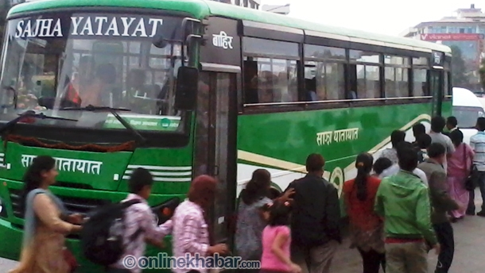
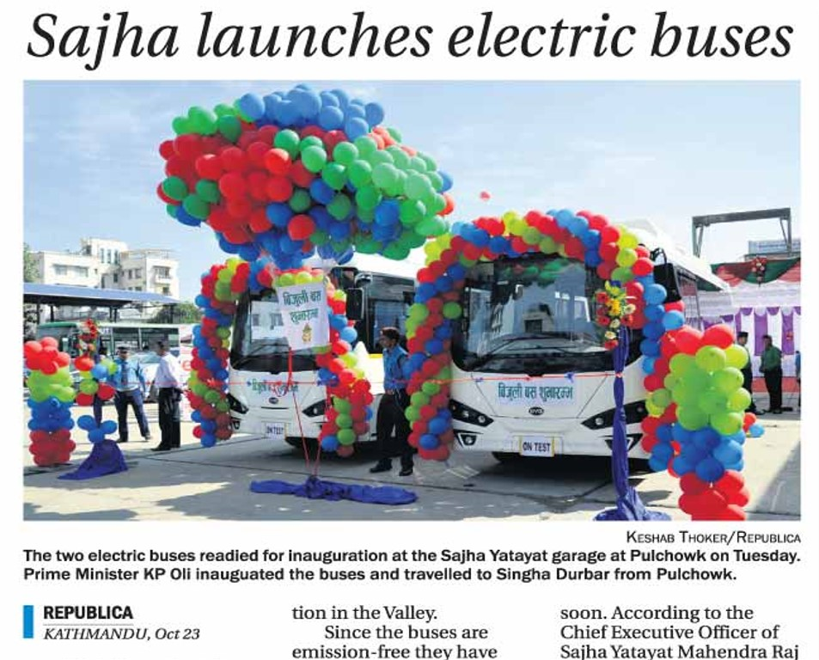
Introduction to Sajha Yatayat
All Public Transport in the city is owned & operated by private sector
Sajha Yatayat – Public Transport Cooperative with majority of government shares
Established 1961; restarted operations 7 years ago
Operating 71 diesel buses
Working with local, provincial & central government to introduce & operate E-Bus

Slide 5
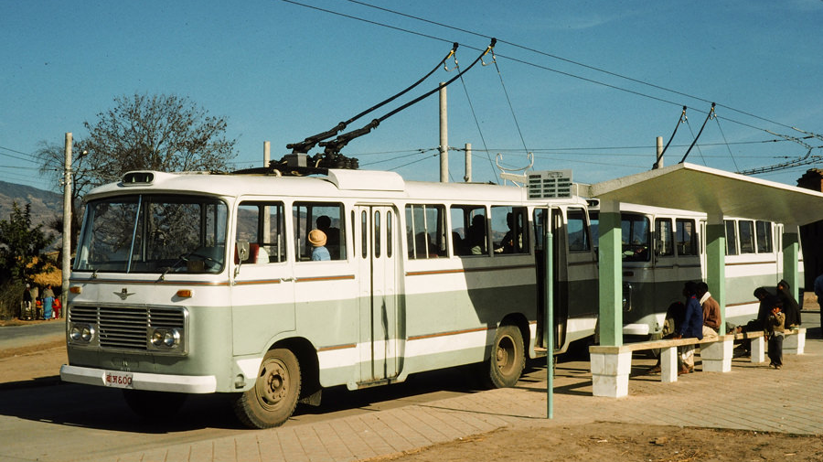
Electric Trolley Buses
Introduced in 1975 (Gift by Chinese Government); no longer in operation

Slide 6
E-three-wheelers (Safa Tempo)
Introduced in 1995 (USAID support); 714 in operation by private sector

Slide 7
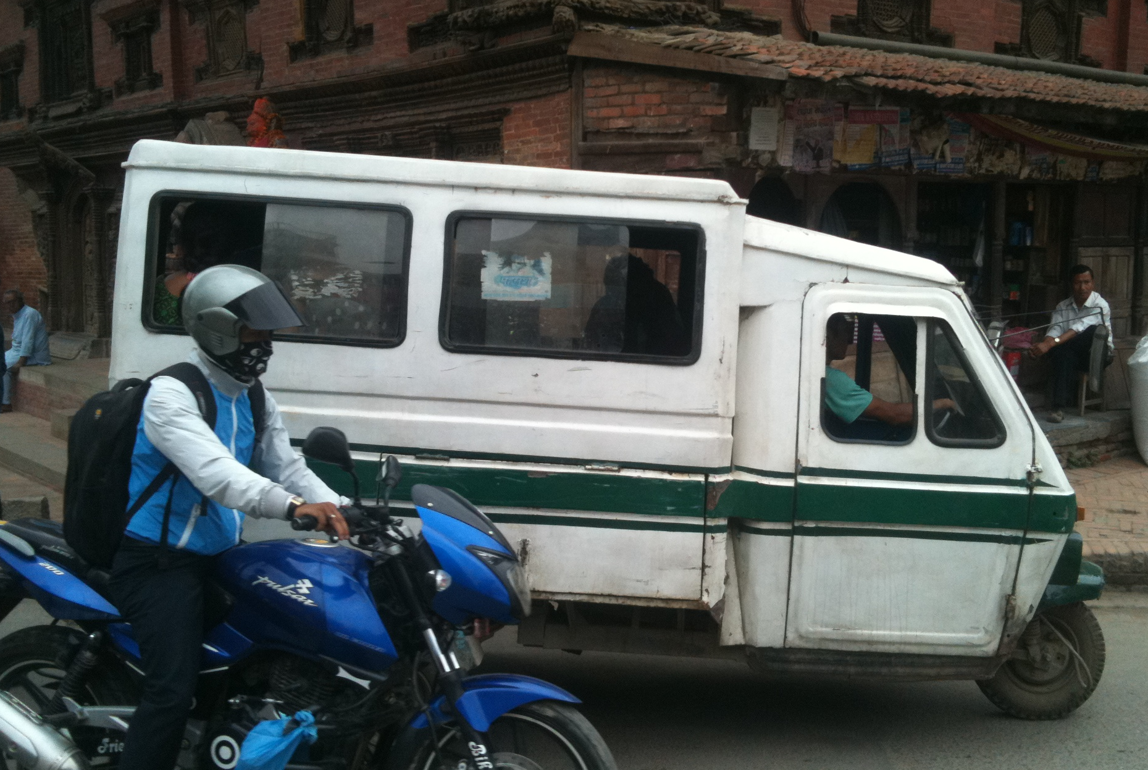
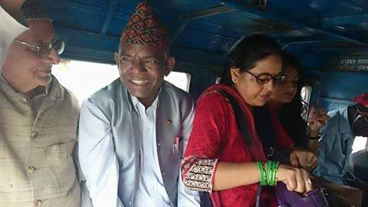
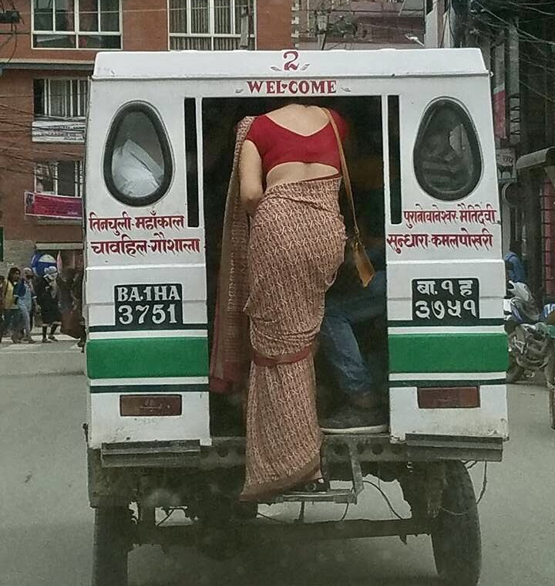
Safa Tempo in Kathmandu
Operating for over 25 years, but very little innovation since beginning
Operates on fixed routes with Battery swapping once a day
100,000 passengers per day

Slide 8
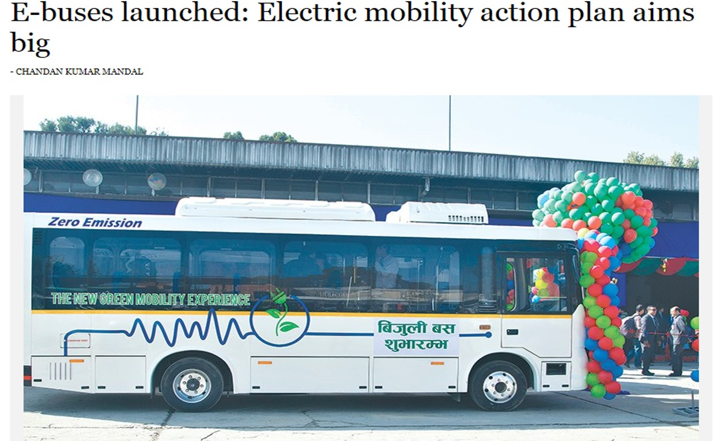
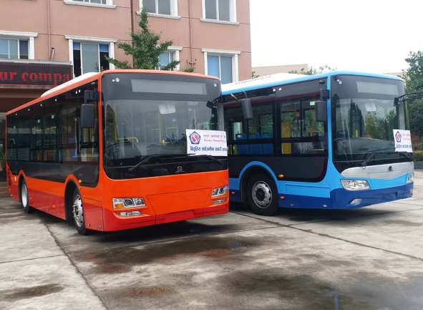
Electric bus
Kathmandu Post 24 October 2018
5 e-buses (7 m) launched by Prime Minister but yet to come into regular operation

Slide 10
EV Policy in Nepal
Environment Friendly Transport Policy 2014/15
Target of 20% EVs by 2020
Nationally Determined Contribution (NDC)
Increase EV by 20% by 2020 compared to 2010
Province 3 Target 100% EV by 2028
Reduced Custom Duty & VAT for EVs
Pollution Tax of Rs. 1.50/l of petrol & diesel
EV Strategy launched by PM
Establish unit for E-mobility
National Program for E-mobility
Financing mechanism

Slide 11
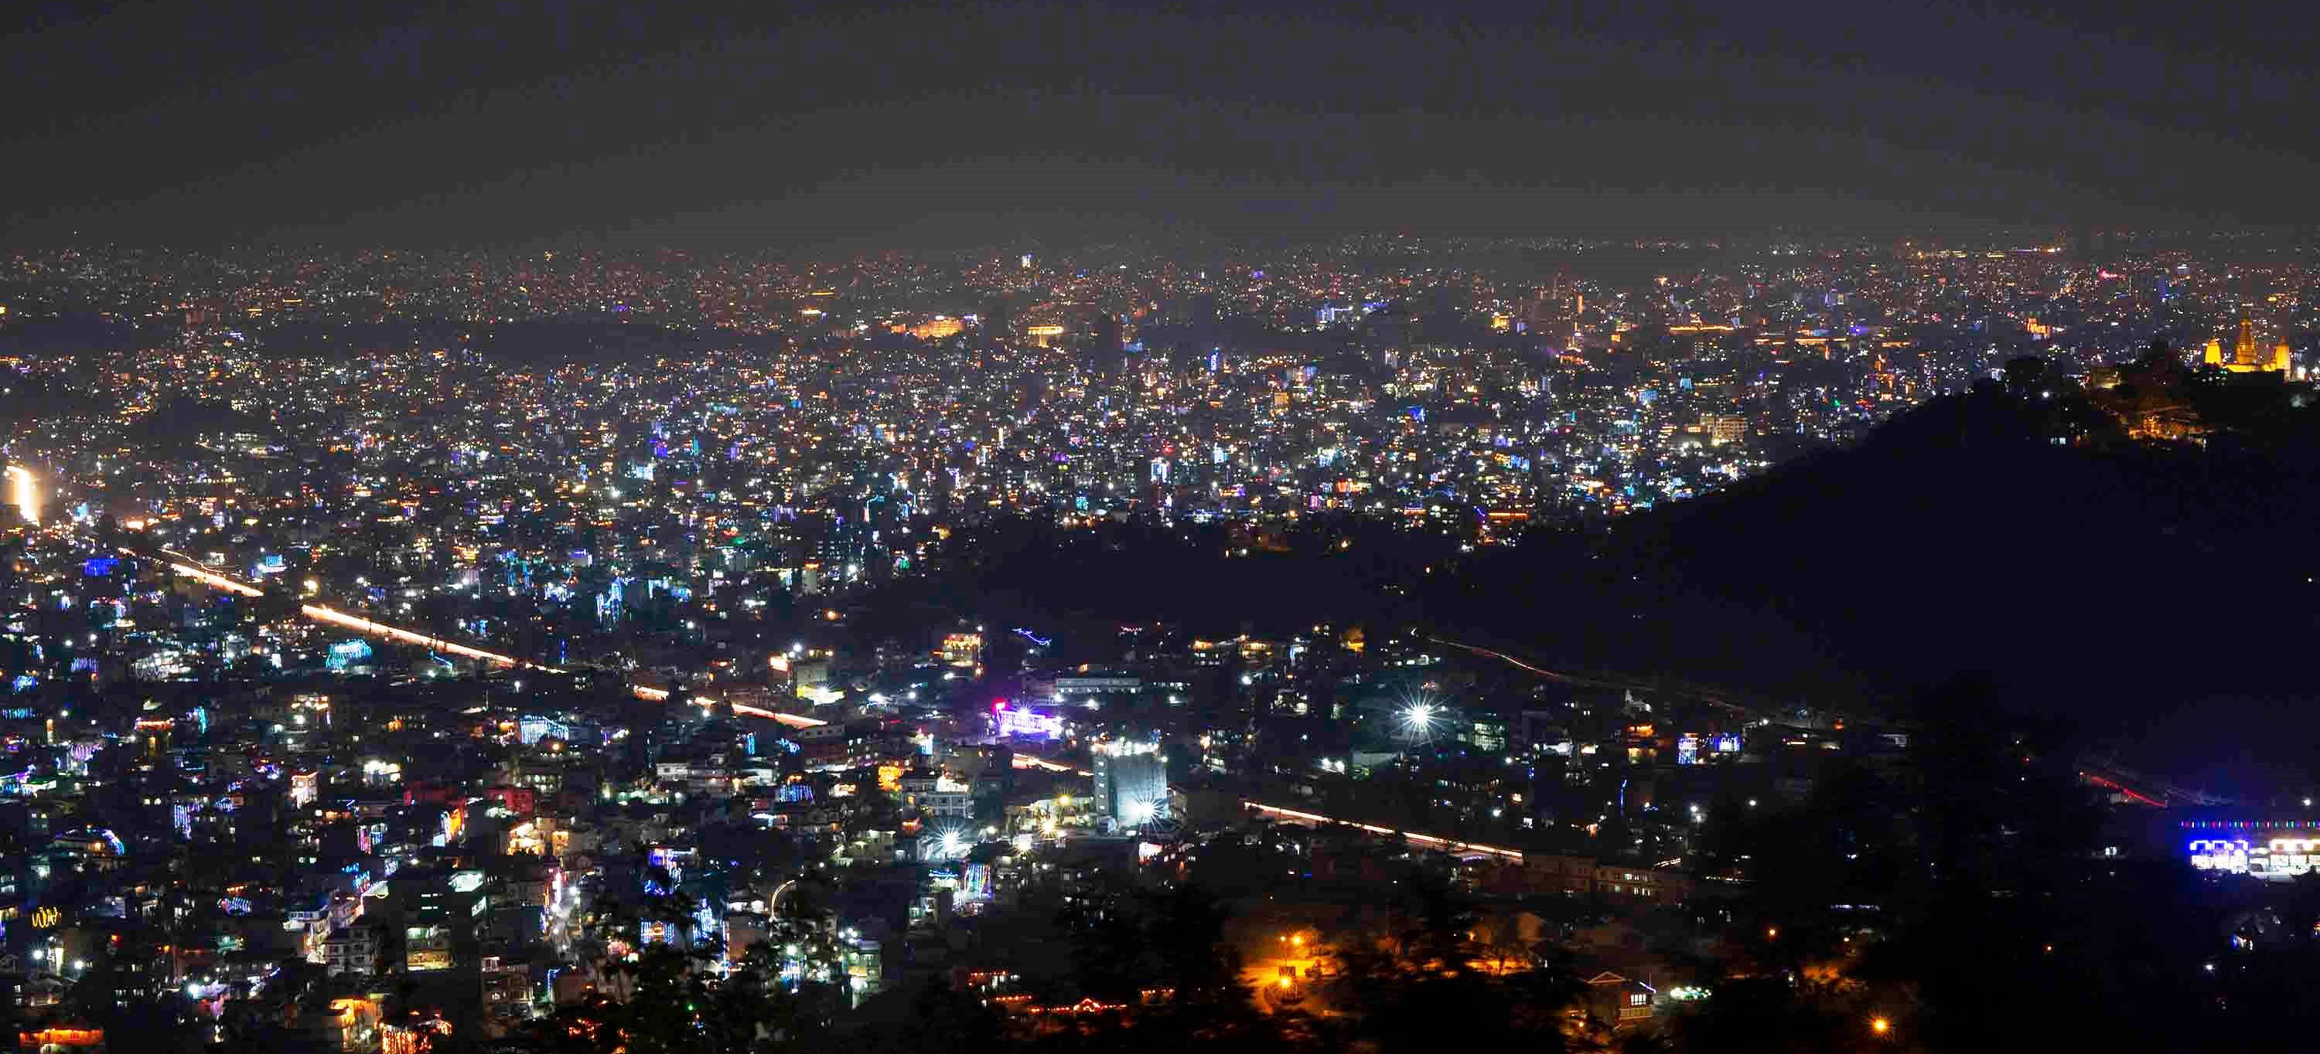
Opportunities for Electric Vehicles in Nepal
Increasing electricity supply - Hydropower
Need to control budget deficit & petroleum is the main contributor
High demand for vehicles – potential to expand public transport
Pollution is seen as a major problem
Some favourable policies
Interest to invest in EVs – Government has allocated funds for E-buses
Photo: Nepali Times

Slide 12
Challenges facing in EVs
Policies
Absence of clear targets & key indicators
Lack of plans & budget to implement policies
Governance
Inadequate planning, management & monitoring of Public Transport
Lack of political support
Technology Infrastructure & Markets
Limited number of suitable vehicle models in the market
Insufficient charging infrastructure
Lack of standards for EVs charging stations, etc.
Poor coordination among relevant agencies
Low consumer confidence and demand
Financing and Resources
Lack of comprehensive financing package with incentives
Lack of investment & business models for e-bus & mass transport
Lack of human resources
Knowledge Management
Inadequate data on transport systems
Insufficient processing and dissemination of data
Inadequate R&D on EVs

Slide 13
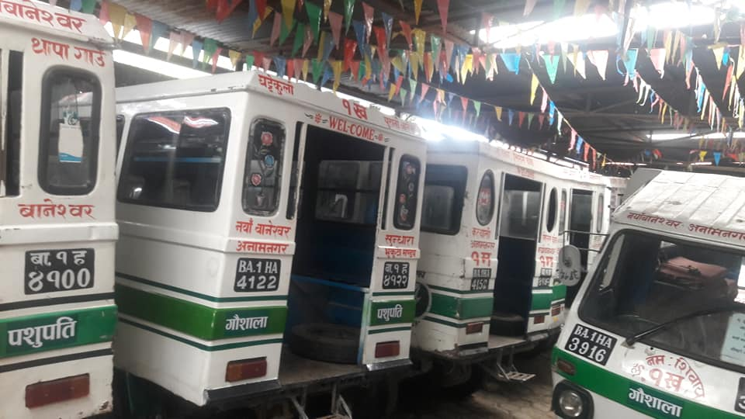
714 Safa Tempo
Stuck for 3.5 months

Slide 14
5
Laxmi Thapa Magar
Safa Tempo Entrepreneur
Main bread winner in a family of six
Earns Rs. 25-30k (USD 210-250)/month
>Rs.1mil(USD 8.3k)loan to buy tempo & battery

Slide 15
Demonstration Actions under SOLUTIONSplus
Establish an eco-system for electric mobility
Demonstrate innovative solutions for electric vehicles, operating systems and integrated public transport system
Conversion of diesel bus to electric
Remodel Safa Tempo
Explore developing E-shuttle van and E-micro bus
Promote ride sharing with electric two wheelers
Explore possibility of an app that allows integrated trip planning and fare payment
Build local capacity (entrepreneur, manufacturer)
Explore appropriate business models and financing options
Demonstration actions are highly replicable in the city and beyond

Slide 16
Modification of Safa Tempo
Redesign E Three-wheelers considering Efficiency, Comfort & safety
Drive train (provided by SOLUTIONSplus Industry partner - Valeo)
Batteries (Li-ion instead of lead acid)
Body modification (exterior & interior to improve looks & allow physical distancing)
Assembled by local manufacturers
Appropriate business model
Testing & documentation

Slide 17
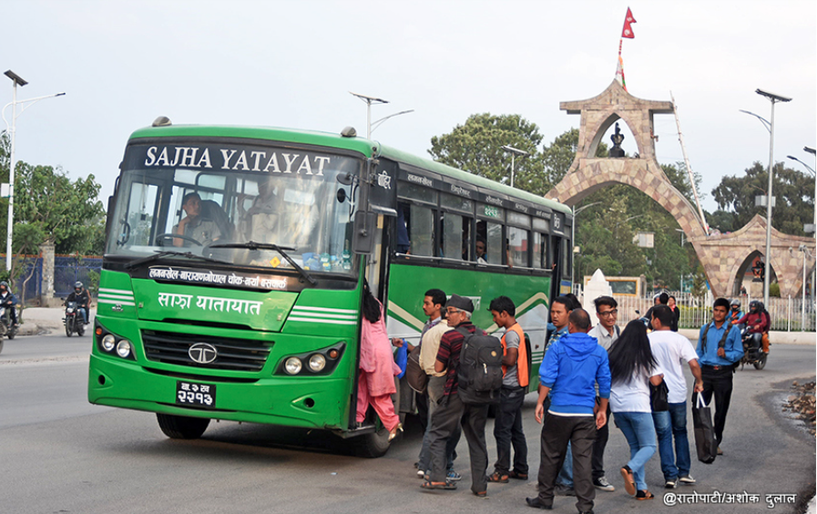
Conversion of Diesel Bus to Electric
Old diesel bus will be converted to electric
8 meter bus (20-25 seater)
Drive train: 80 kw rated power
Battery: 120 kwh lithium ion battery
Charging: overnight plug in

Slide 18
Other planned actions under the project
Interaction between EU industry and local business
Support on EV policy development
Training on e-mobility for different stakeholders (including e-learning/e-courses)

Slide 19
Contact
Bhushan Tuladhar
Sajha Yatayat
Lalitpur, Nepal
bhushan.tuladhar@gmail.com
977-9851017819

