Slide 1
Notes:
Assoc. Prof. Vu Ngoc Khiem, PhD
Nguyen Thi Thu Hien, MA

Slide 2
Part 1: Hanoi e-mobility overview
Hanoi overview & University of Transport Technology
Hanoi Mobility and Air Quality Issues
Hanoi Green Transportation Initiatives
Part 2: Hanoi demonstration of e-mobility solutions
Demonstration Objectives
Identification of Locations
Identification of E-scooters

Slide 4
HANOI CITY OVERVIEW A capital city of fast growth
Population: 8 million
Area: 3.329 km2
Highest population density: 42,000 people/km2
Urbanization rate: 49,2%
Transport network: 1,147 roads with 2,052 km long; Motorbikes growth: 12%-15%/year
Notes:
Hanoi is the capital city of Vietnam and the second largest city of the country, just behind Ho Chi Minh City. During the last two decades, Hanoi developed fast and expanded steadily. Since the city acquired large parts of the surrounding provinces in 2008, Hanoi tripled its size and doubled its population. The new development aims to spread the concentrated population and economic activities to alleviate the stress caused by pollution and the decreasing quality of life of the residents.

Slide 5
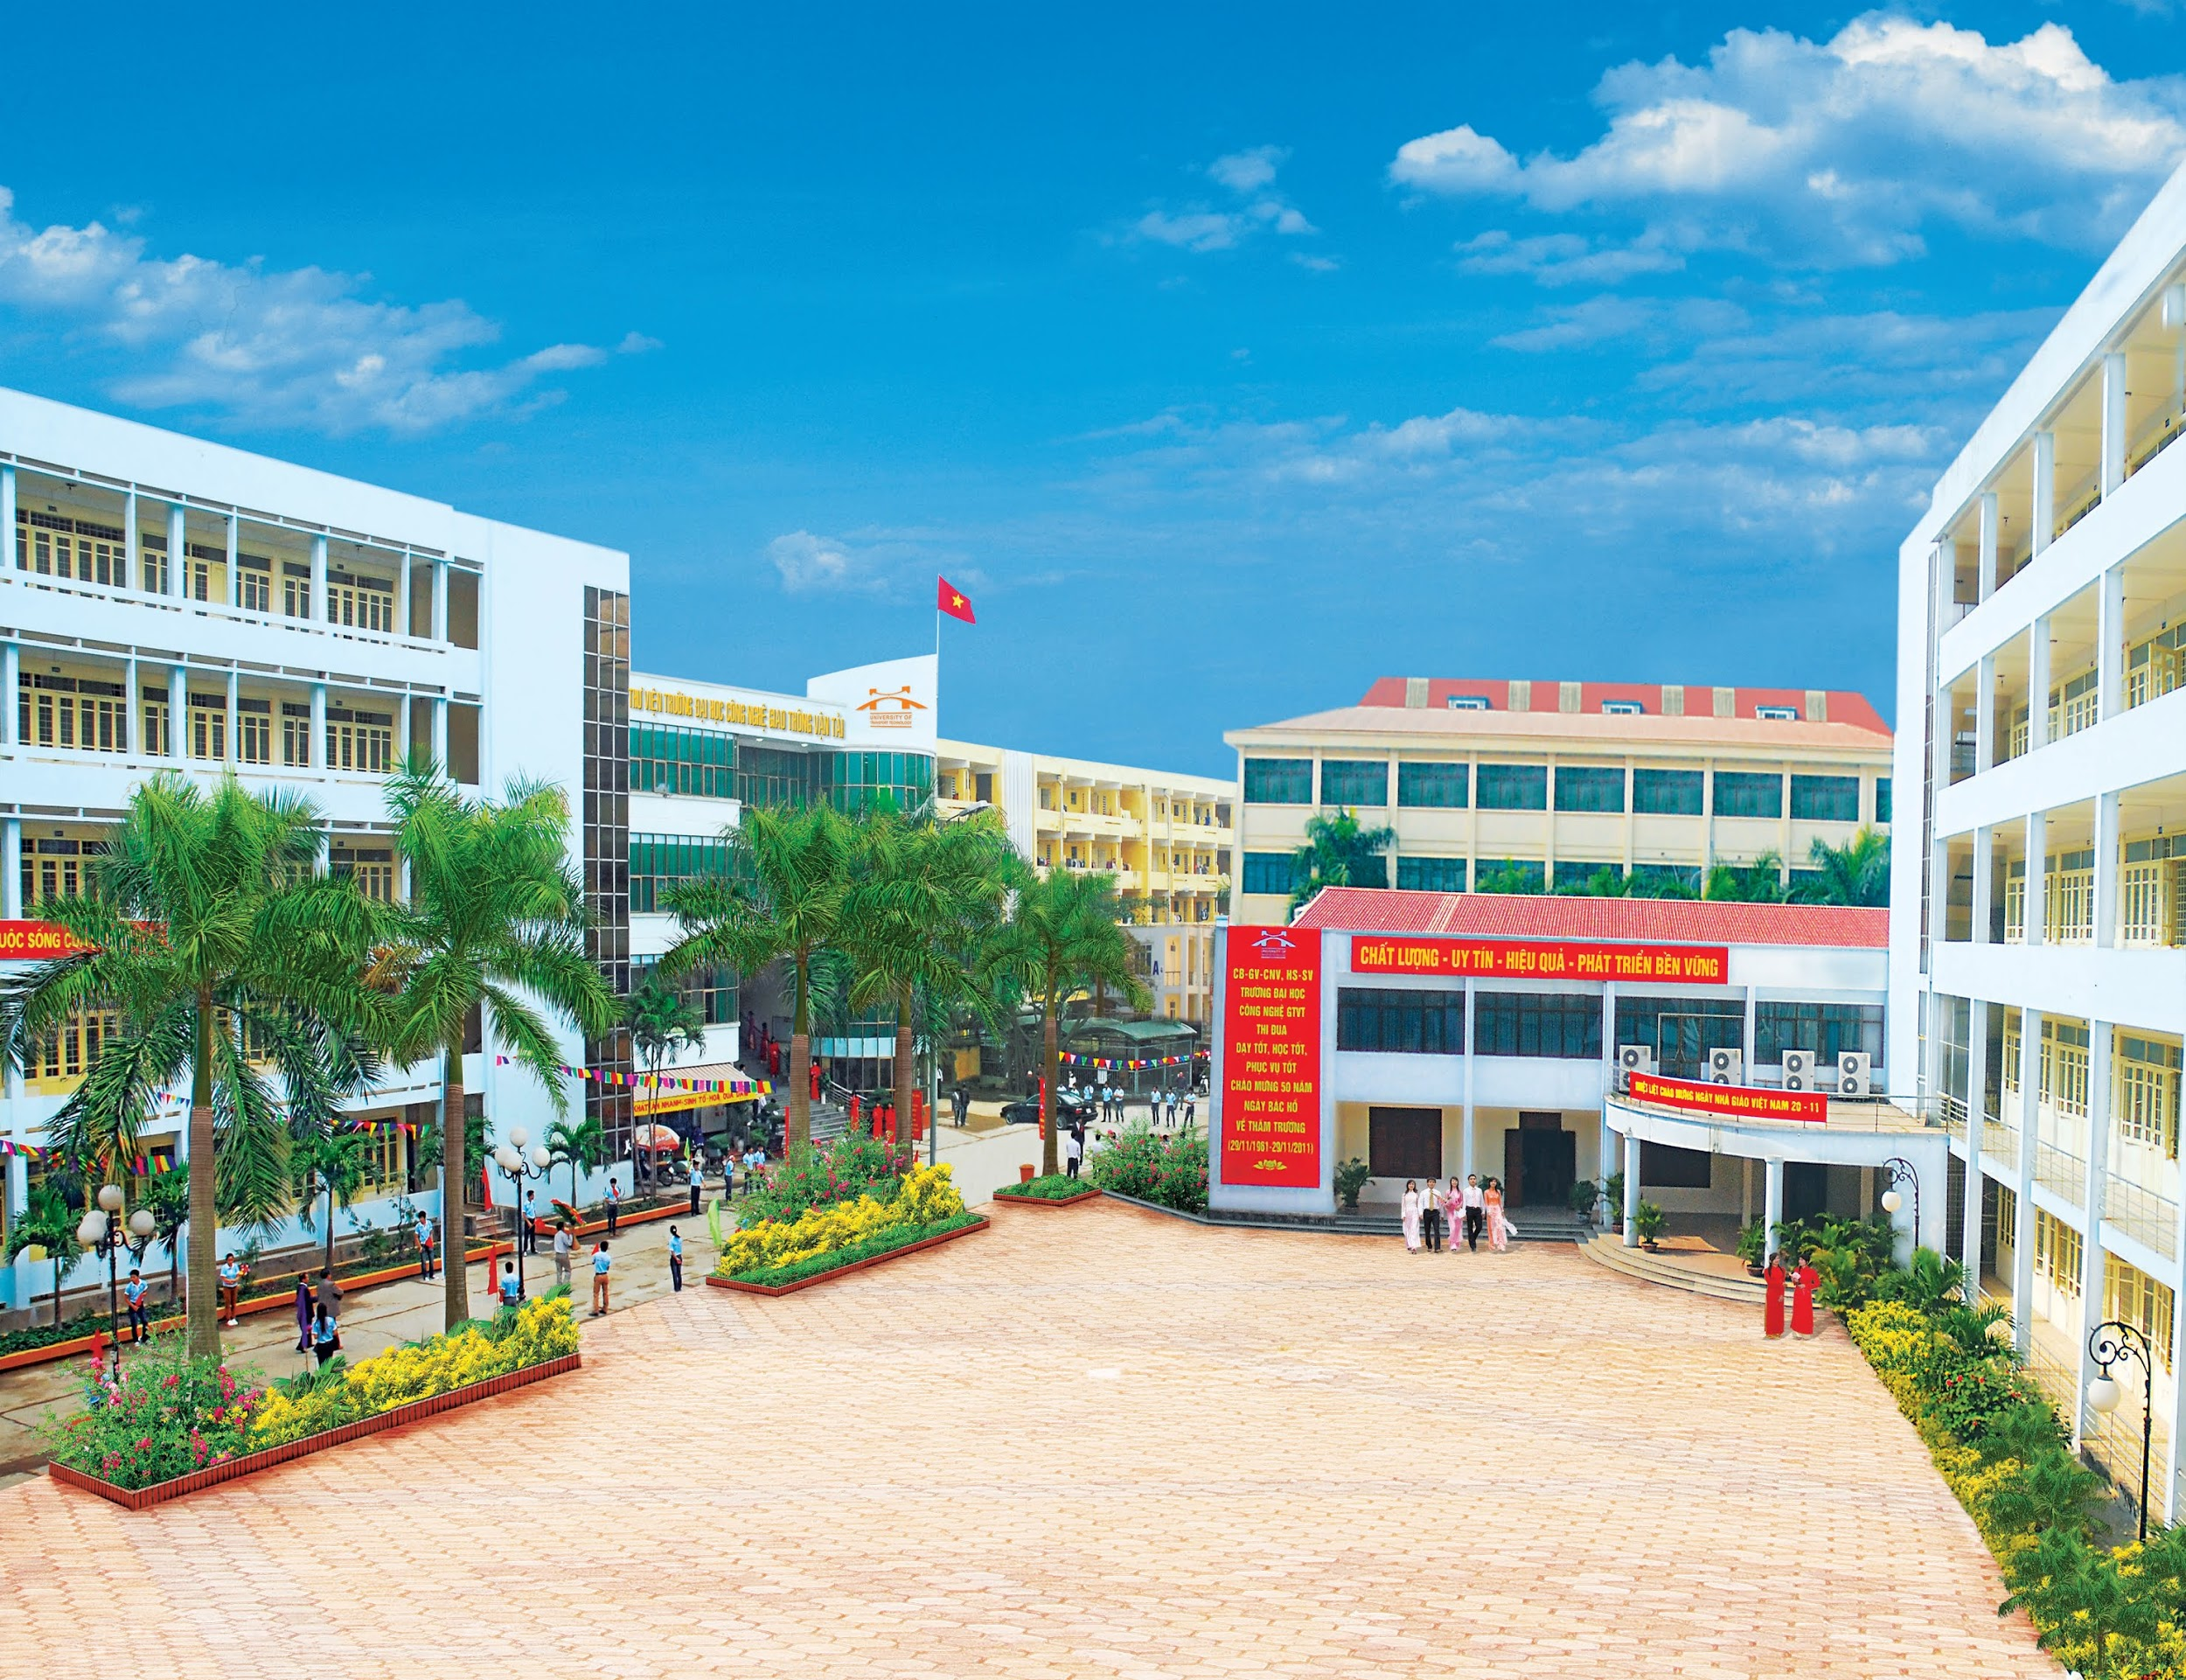
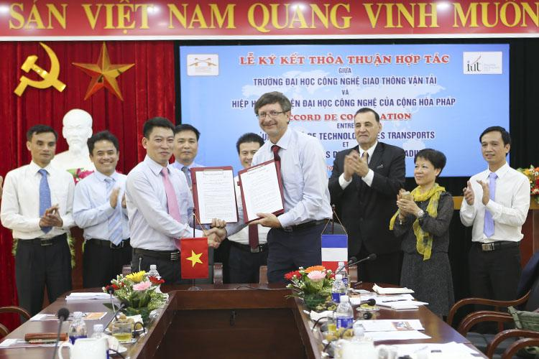
UNIVERSITY OF TRANSPORT TECHNOLOGY
Established since 1945, under Vietnam Ministry of Transport.
13,000 students
700 lecturers & staffs
Provide training courses at Post-graduate, undergraduate level in 4 majors: Civil engineering; Mechanical engineering; IT, Electronics & Telecommunication; Economics and Transport Operation.
Researching, Technology Transferring in the Transportation sector and other industries.
Cooperating with 56 international partners
200 researches at UTT level
29 researches at MOT level
5 years
15 projects of environmental topics
6 new Vietnam National Standards, Renovation of 15 Sector standards to National standards
06 researches at National level
09 International projects

Slide 6
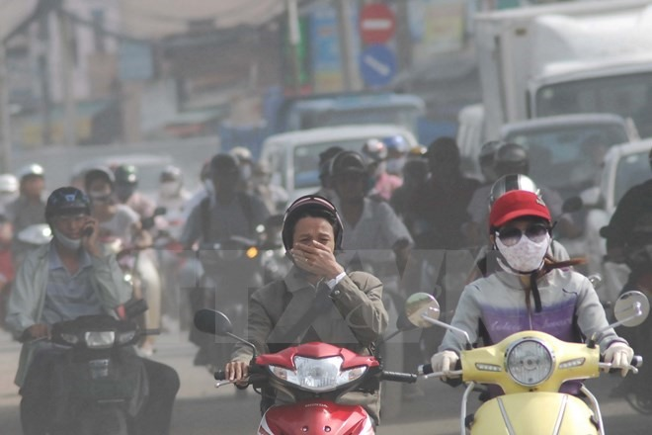
HANOI OVERVIEW Hanoi mobility and Air quality issues
An inadequate public transportation system
A large and increasing number of fossil-fuel powered vehicles
Mode Shares of Trips in Hanoi
THEREFORE:
More air pollution
More congestion
More stresses on urban mobility
Sources: Hanoi Police and Vietnam Register, 2019
Notes:
The transportation sector in Viet Nam currently faces a twofold problem: (1) an inadequate public transportation system unable to meet the demand from the fast growing population; and (2) a large amount and increasing number of fossil-fuel powered vehicles, especially 2-wheelers, which cause frequent and severe traffic jams. The consequence of these issues is perhaps an even more severe problem, which is an extremely and progressively poorer air quality, caused by the significant emissions of exhaust gases and fine particulate matter from fossil-fuel engines.

Slide 7
HANOI GREEN TRANSPORTATION INITIATIVES Government and City policies & projects
Intended Nationally Determined Contribution (INDC), 2015 after Paris Agreement
Greenhouse gas (GHG) reduction by 2030: 8% (unconditional) and 25% (conditional, depending on foreign financial support).
For the transport sector, two measures: converting fuel use (with an estimated mitigation of 9.9 million tCO₂) and shifting mode of transportation (with an estimated mitigation of 26.7 million tCO₂)
Government Decision 16/2019/QD-TTg, 2019 regulating on the application of the emission standards of in-use and imported automobiles. Standards and application roadmap were developed by UTT under MOT.
To further reduce the concentration of CO contaminants (carbonates), HC (hydrocarbons) and the level of smoke in automobile emissions to the environment.
Decision No. 04/2017/QD-TTg dated March 9, 2017 of Prime Minister regulating on motorbikes that must apply compulsory energy labelling from January 1, 2020 to limit the energy inefficient vehicles.
Hanoi Project “Strengthening management of road transport vehicles to reduce traffic congestion and environmental pollution in Hanoi in the period 2017-2020 and vision to 2030” - Resolution No. 04/2017/NQ-HDND dated July 4, 2017.
Restrict motorbikes by 2030
Introduce more public transportation
A pilot of electric cars (primarily for tourism purposes) was conducted in the City of hanoi in 2012. The cars were tested in the Old quarter, and near the Tay Lake.
Notes:
Viet Nam submitted the Intended Nationally Determined Contribution (INDC) to the UNFCCC on 29 September 2015. INDC became the first Nationally Determined Contribution (NDC) on November 3, 2016 after Viet Nam approved the Paris Agreement. The NDC sets two targets for greenhouse gas (GHG) reduction by 2030: 8% (unconditional) and 25% (conditional, and depending on foreign financial support). For the transport sector, the NDC includes two measurements: converting fuel use (with an estimated mitigation of 9.9 million tCO₂) and shifting mode of transportation (with an estimated mitigation of 26.7 million tCO₂), which can only be achieved if a supportive framework of policies and regulations is put in place.

Slide 8
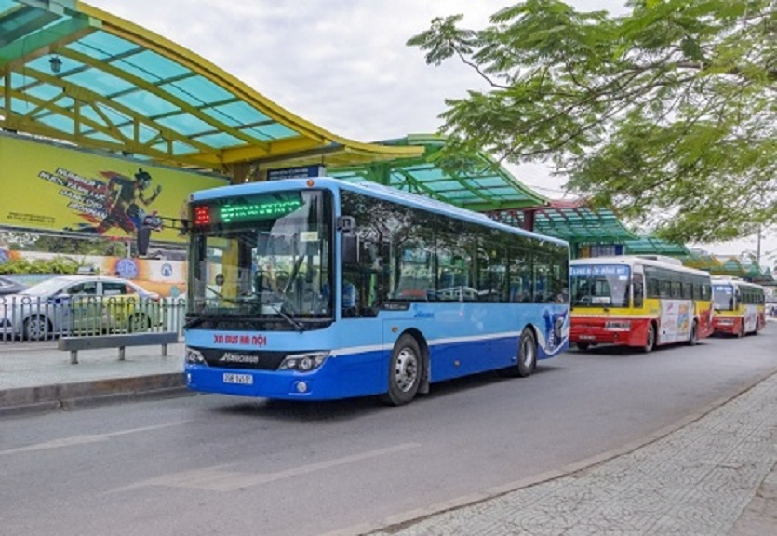
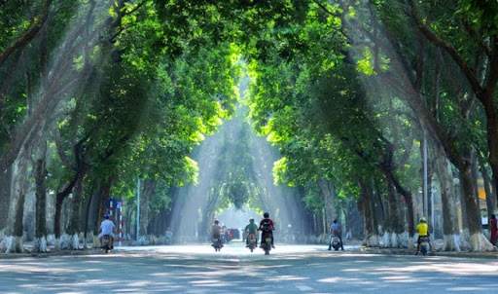
HANOI GREEN TRANSPORTATION INITIATIVES International projects
The UNEP – UTT Hanoi project “Mainstream electric mobility in Vietnam“ involving a feasibility study, technical assessment, standards and policy support and pilot demonstration focusing on electric 2-wheelers, 2018-2020.
The project “Promotion of Electric Two-Wheelers and Solar Energy in Vietnamese Cities: an Explorative Project Initiated and Tested in Hanoi“ was conducted by Caritas Switzerland together with BK-Holdings between 2013 – 2018.
A low carbon bus NAMA has been registered by Viet Nam at the UNFCCC, which set a target for 2030 that 10% of all newly acquired buses have to be electric.
Notes:
This policy aims to reduce environmental pollution and traffic jams by limiting the circulation of all kind of 2-wheelers in specific districts and in general to limit the number of air-polluting 2-wheelers. These ambitious targets can only be achieved if concomitantly the development of alternative transport options, such as electric vehicles and public transportation systems, are facilitated, which has not been done by the local government in Ha Noi. Gaps and needs created by this Resolution can all filled by implementing the activities specifically designed for Ha Noi, the selected pilot city.

Slide 10
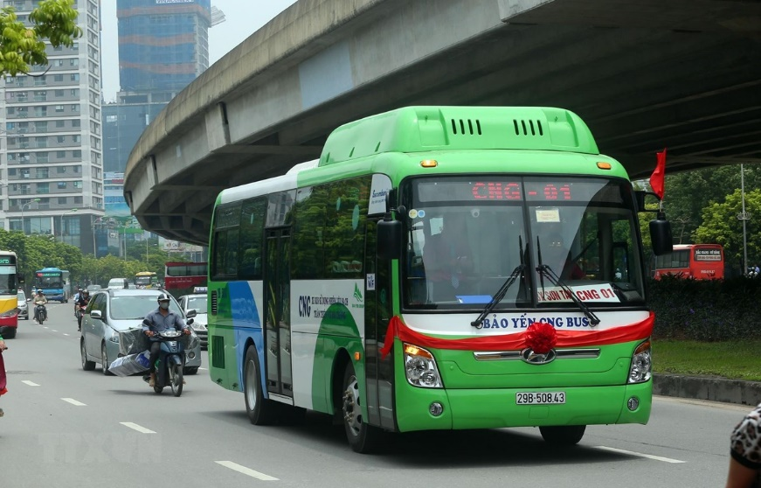
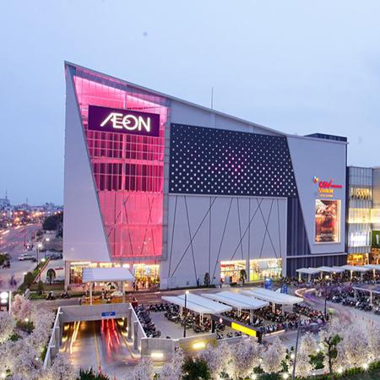
HANOI DEMONSTRATION ACTIONS Demonstration Objectives
E-mobility solutions to enhance the last-mile connectivity
Demonstration of e-scooter sharing
MaaS/sharing app introduction in Hanoi
Concept/prefeasibility study for scale-up is developed
Conditions for enabling accelerated e-mobility uptake and integration are improved
Business models and business plans are developed and validated
Interactions between EU industry and local businesses are established and documented
Recommendations for policy development, institutionalization and integration of e-mobility in local and national plans are developed
Funding, financing, and procurement for e-mobility program proposal is developed
Local capacities relating to e-mobility are enhanced
Peer-to-peer exchange program is conducted and documented
Toolkit for e-mobility is developed and shared with local stakeholders
Local training activities directly related to the demonstration action is developed and delivered
Notes:
Hanoi e-mobility for last-mile connectivity: The demonstration project will focus on boosting the ridership and effectiveness of the currently running BRT and the forthcoming metro rail with a first 50 shared E-scooter system as last-mile connectivity. The project will be a win-win for both public transport and e mobility. A technical support team will design and develop vehicles that are tailored for the local context and operated under the oversight of the local public transport operator and the city of Hanoi.
Smart services, fleet bundling, E-scooter GPS positioning that support eco-routing will also be the part of the project (SOL+ MaaS App). The demonstration project will have a high potential to not only make emobility attractive but also reduce the GHG emissions from transport and increasing the share of public transport use.

Slide 11
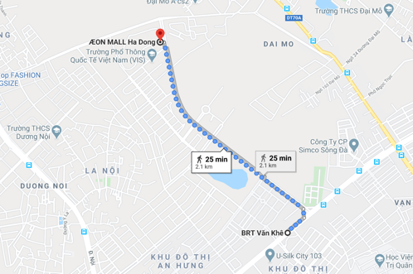
HANOI DEMONSTRATION ACTIONS Hanoi e-mobility for last-mile connectivity
Locations
1st phase: BRT Van Khe – Aeon Mall Ha Dong
2nd phase: Metro lines – Residential areas
Vehicles & charging
50 shared e-scooters, ABB charging for Vinfast e-buses for the first phase
Integration
Maas app, Sharing app
Notes:
The demonstration will be conducted in phases. For the first phase, there will be a trail with 50 shared e-scooters to test the sharing system to facilitate the traveling from BRT stop to a shopping mall and vice versa. There will be periodically assessment on the system to see what is good, what needs to be improved for the better pilot. After that the sharing system will be replicated to other locations in the city, probably connecting the Metro terminal with residential areas.

Slide 12
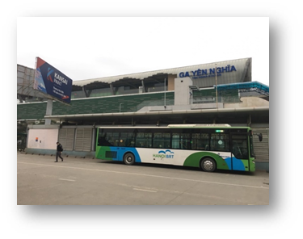
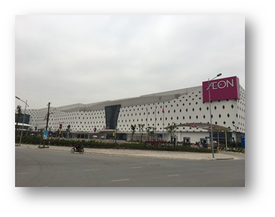
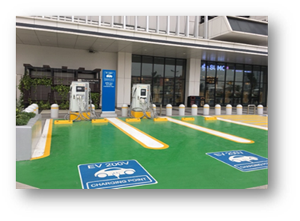
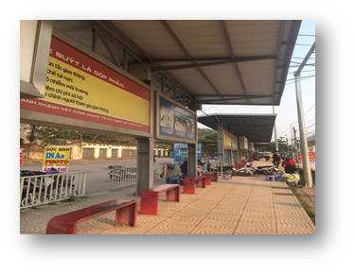
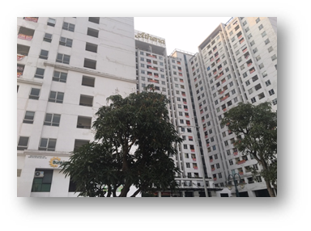
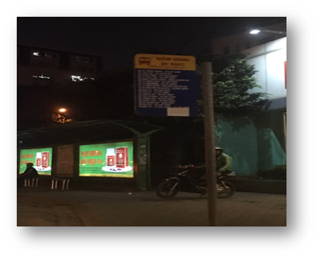
HANOI DEMONSTRATION ACTIONS Identification of Locations
Bus/BRT/Metro terminals | Residential areas/shopping malls/ student dormitories | Parking areas for shared e-scooters

Slide 13
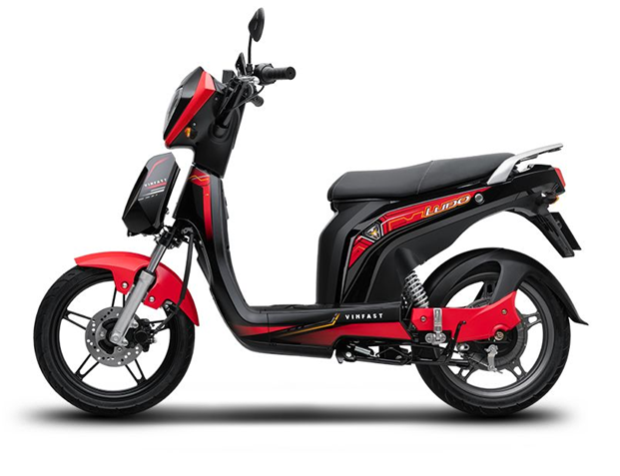
HANOI DEMONSTRATION ACTIONS Identification of E-scooters
Vinfast Ludo:
•Battery: LiFePo4 (LFP)
•Range: 43 miles
•Charge Time: 5 hours
•Power: 1.1 kW (1.5 hp)
•Equipped with 3G, Bluetooth, GPS, eSIM connectivity and connects to a smartphone.
•Everything from battery monitoring to GPS to ride history, the Vinfast app keeps the driver connected and up-to-date with the whereabouts of the scooter.

Slide 14
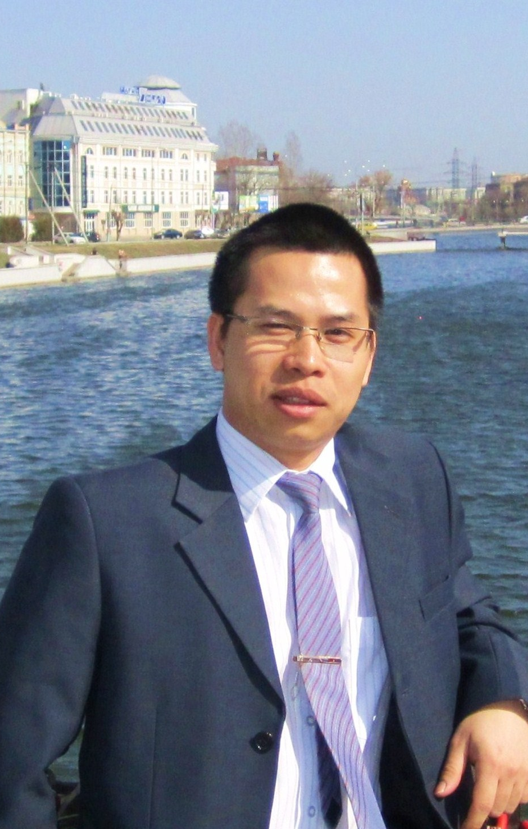
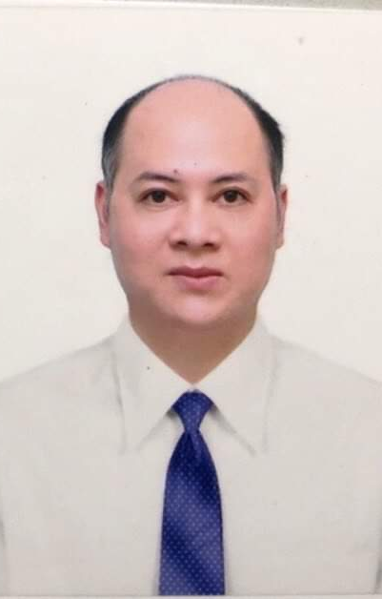
HANOI DEMONSTRATION ACTIONS Local implementation team
Project Management
Vehicles and Technical Aspects
Transport Operation
Software and Integration

Slide 15
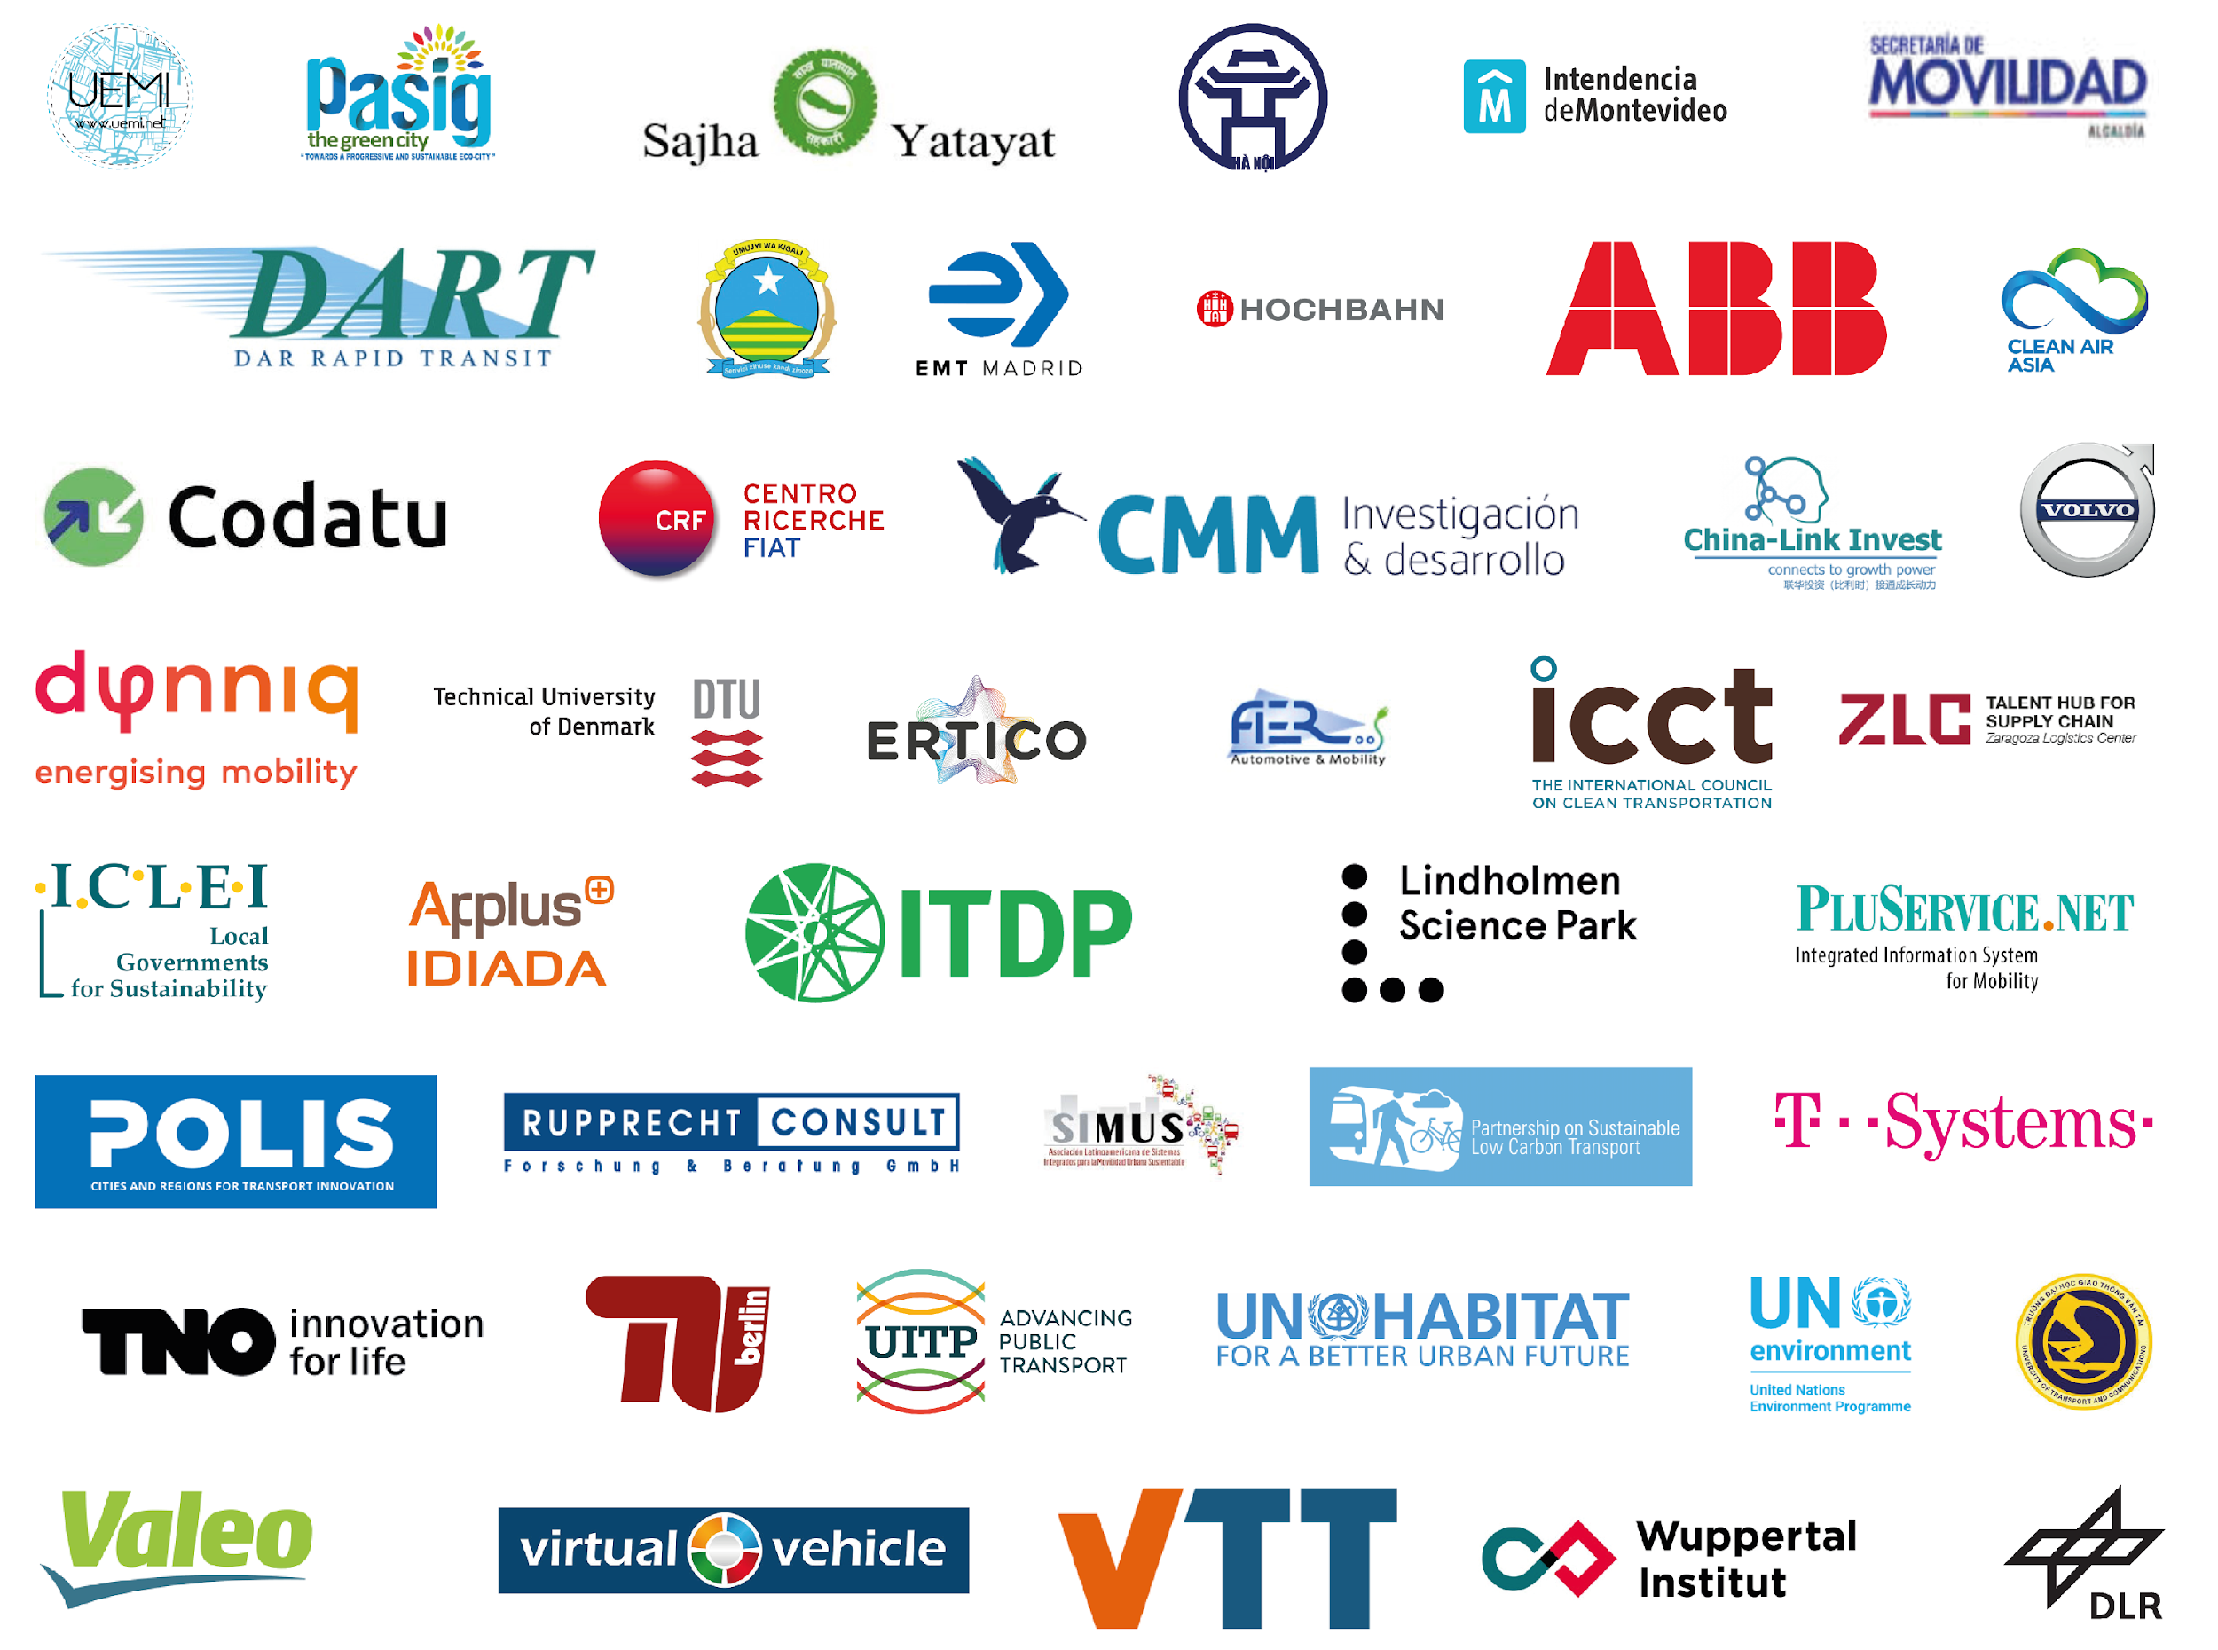
Thank you for your kind attention!

Slide 16
Nguyen Thi Thu Hien, M.A
University of Transport Technology
No. 54 Trieu Khuc, Thanh Xuan, Hanoi, Vietnam
Email: hienntt@utt.edu.vn
Tel: +84.2435527876
Mobile: +84 988022068, Skype: hien_utt

